Slide 1
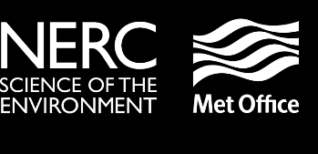
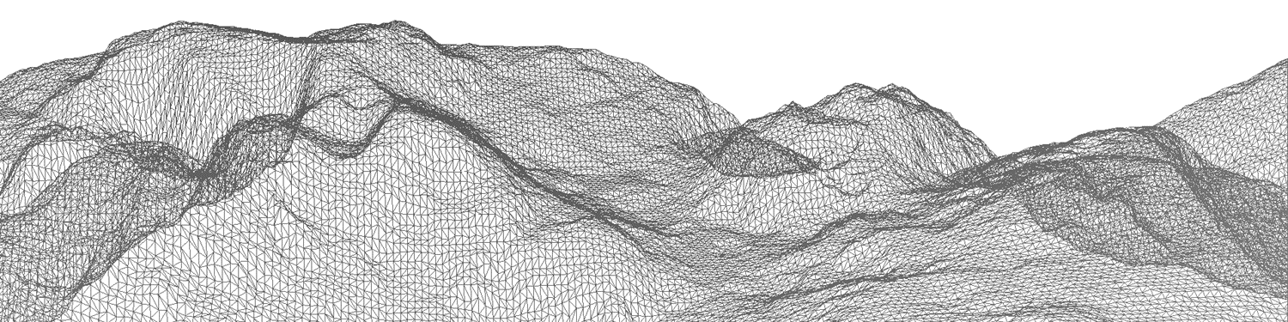
Advection over steep slopes
#ecmwfnumerics2016
James Shaw @hertzsprrrung
Hilary Weller @hilaryweller0
John Methven
Terry Davies

Slide 2
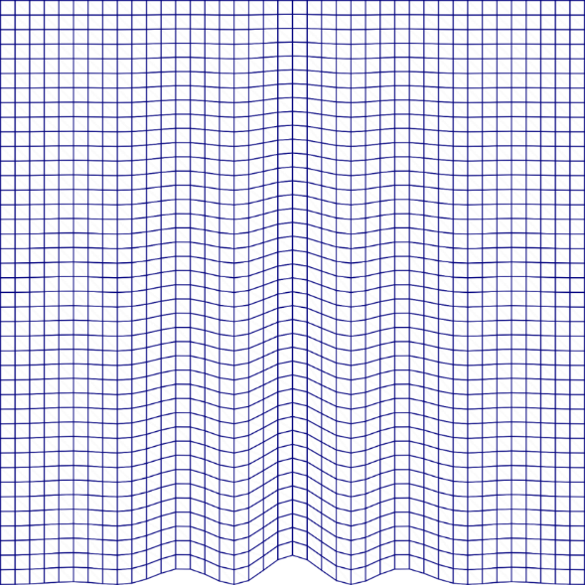
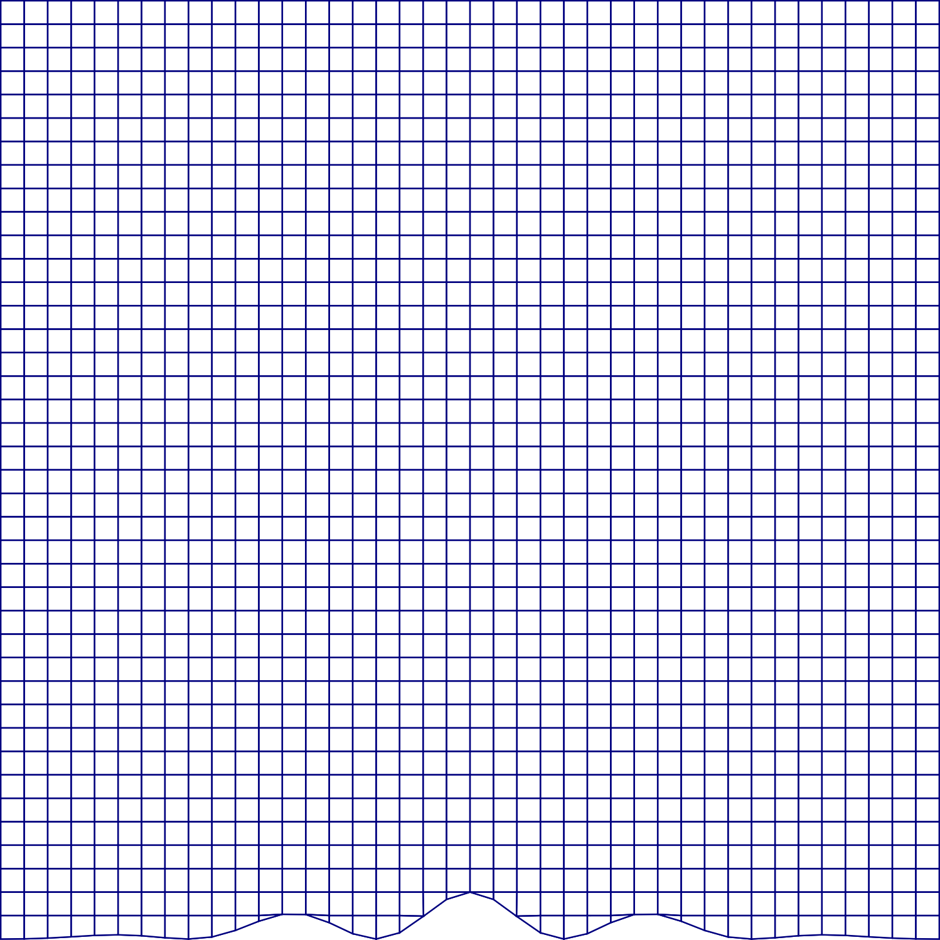
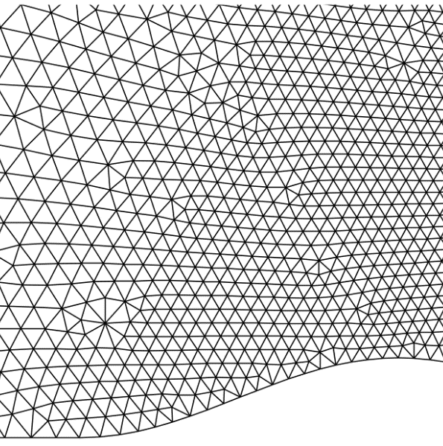
ways to represent terrain
Terrain following layers
Cut cells
Unstructured
Source: Smolarkiewicz & Szmelter
http://ral.ucar.edu/hap/events/orographic-precip/images/2wed/am/day2-Wed_am_3-Orogunmesh2.ppt

Slide 3
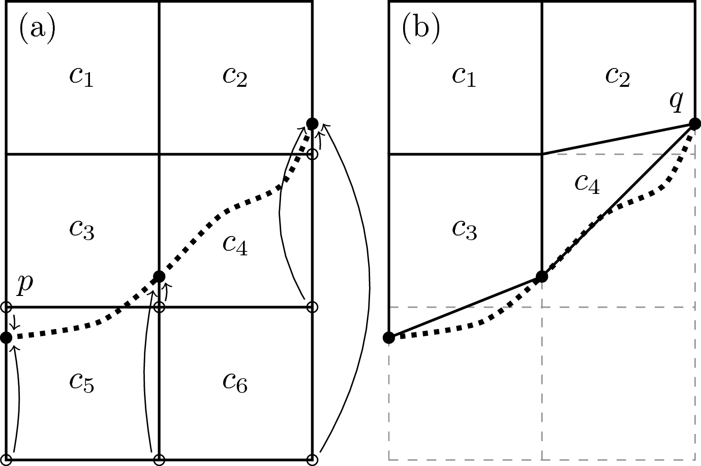
Slanted Cells
Before
After

Slide 4
Slanted Cells
Before
After

Slide 5
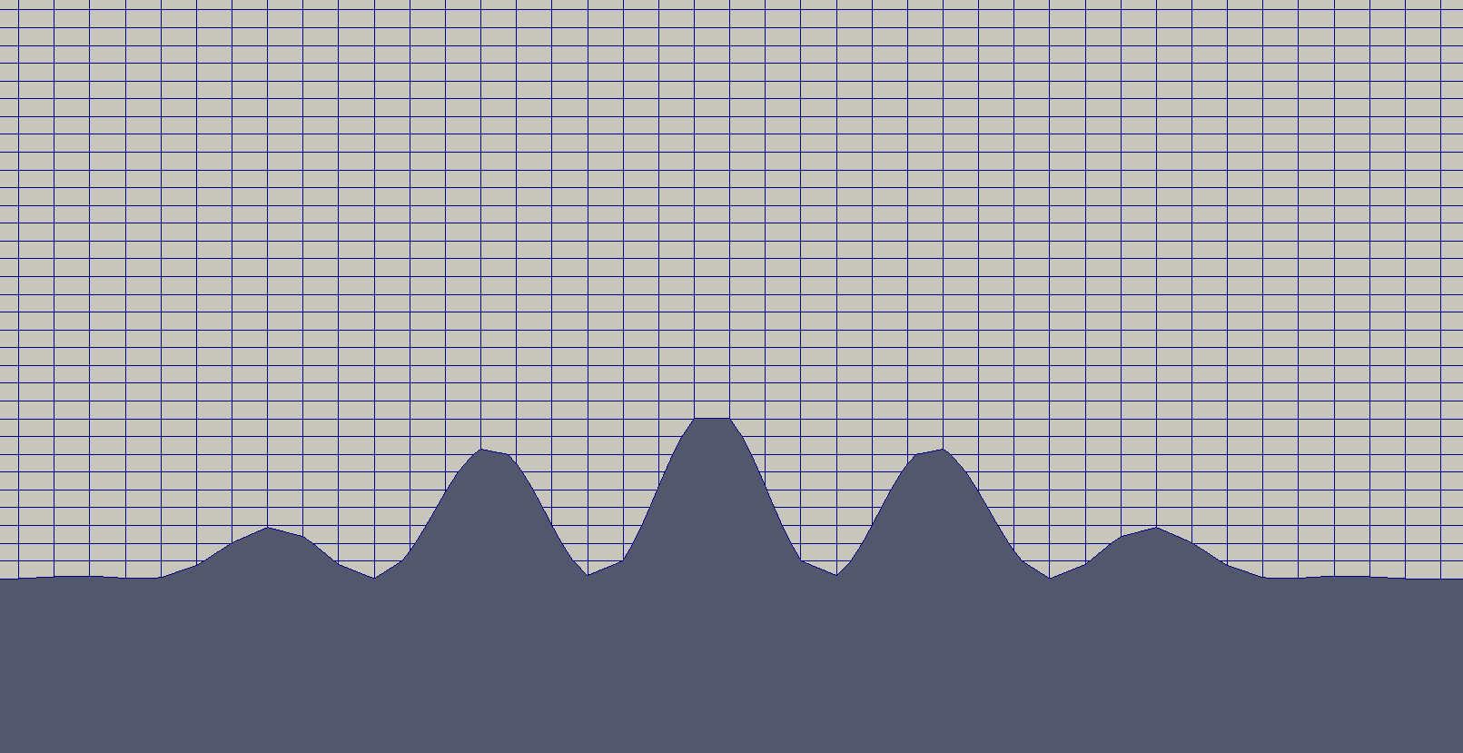

Cut Cells
Slanted Cells
Source: Shaw & Weller 2016, MWR, dx.doi.org/10.1175/MWR-D-15-0226.1

Slide 6
Slanted Cells
Easy to construct
Avoid arbitrarily small cells
Generalise to 3D with arbitrary horizontal meshes

Slide 7
cubicFit: An Advection scheme for steep slopes

Slide 8
cubicFit: An Advection scheme for steep slopes
Finite volume
Eulerian
Multidimensional cubic approximation
Method-of-lines with Runge-Kutta timestepping
No flux correction
Not monotonic

Slide 9
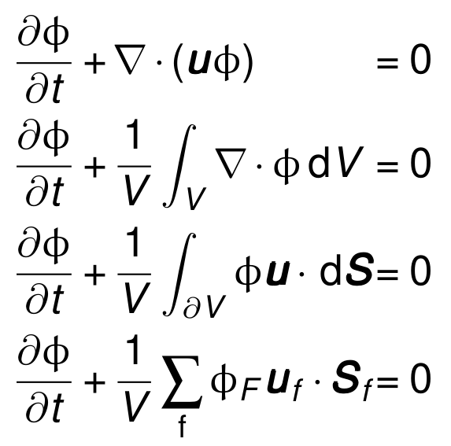
Finite volume discretisation

Slide 10
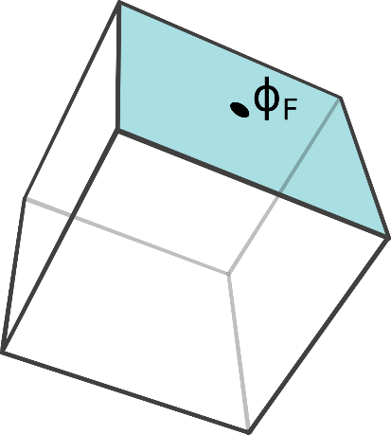
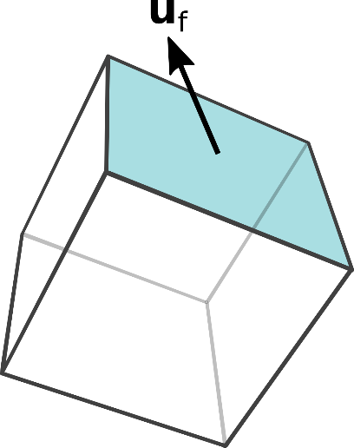
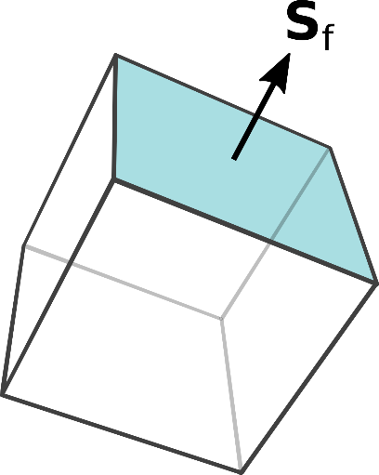
Finite volume discretisation

Slide 11
How to EstimatE φ_{F}?

Slide 12
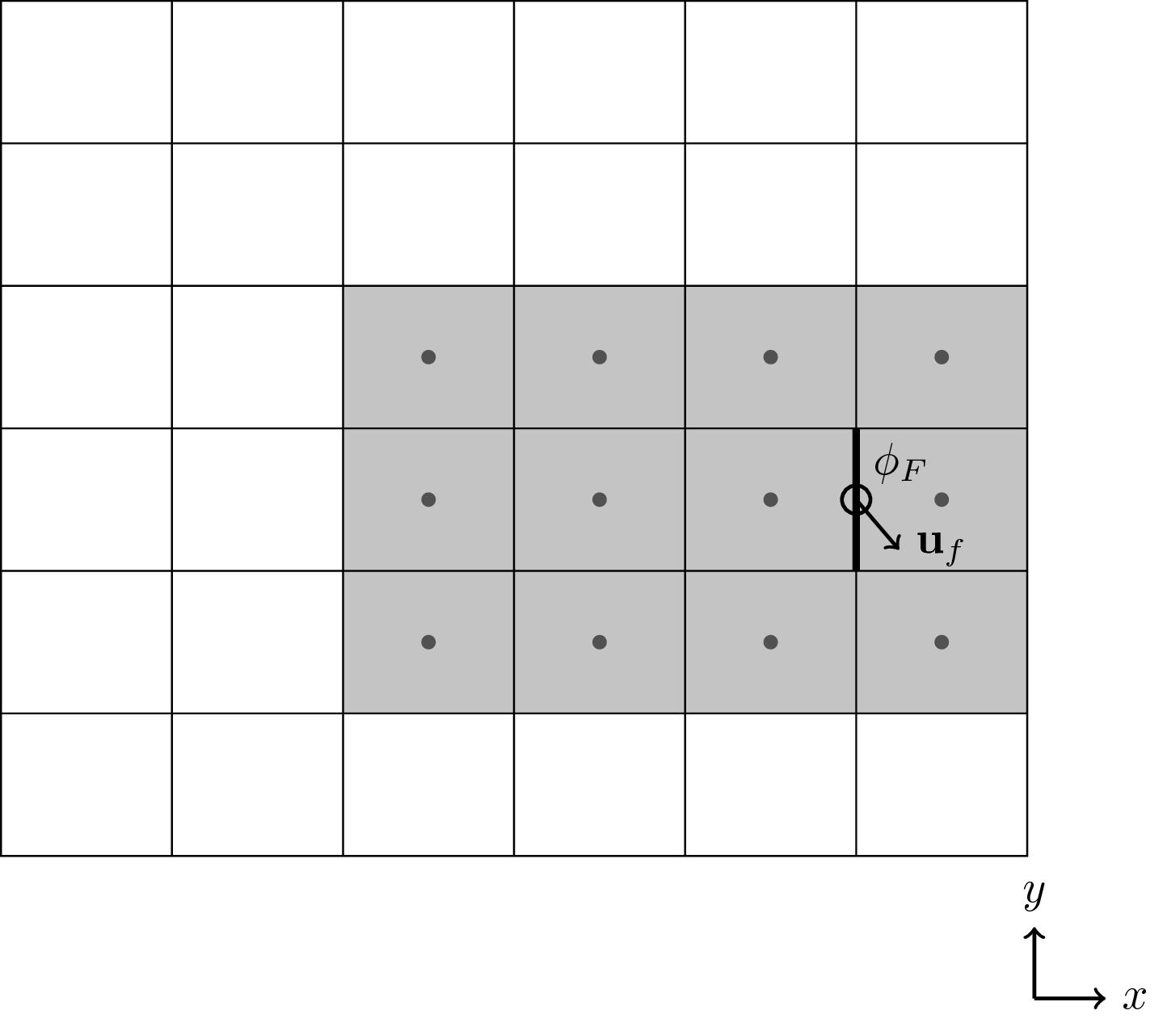



Upwind-Biased stencil

Slide 13
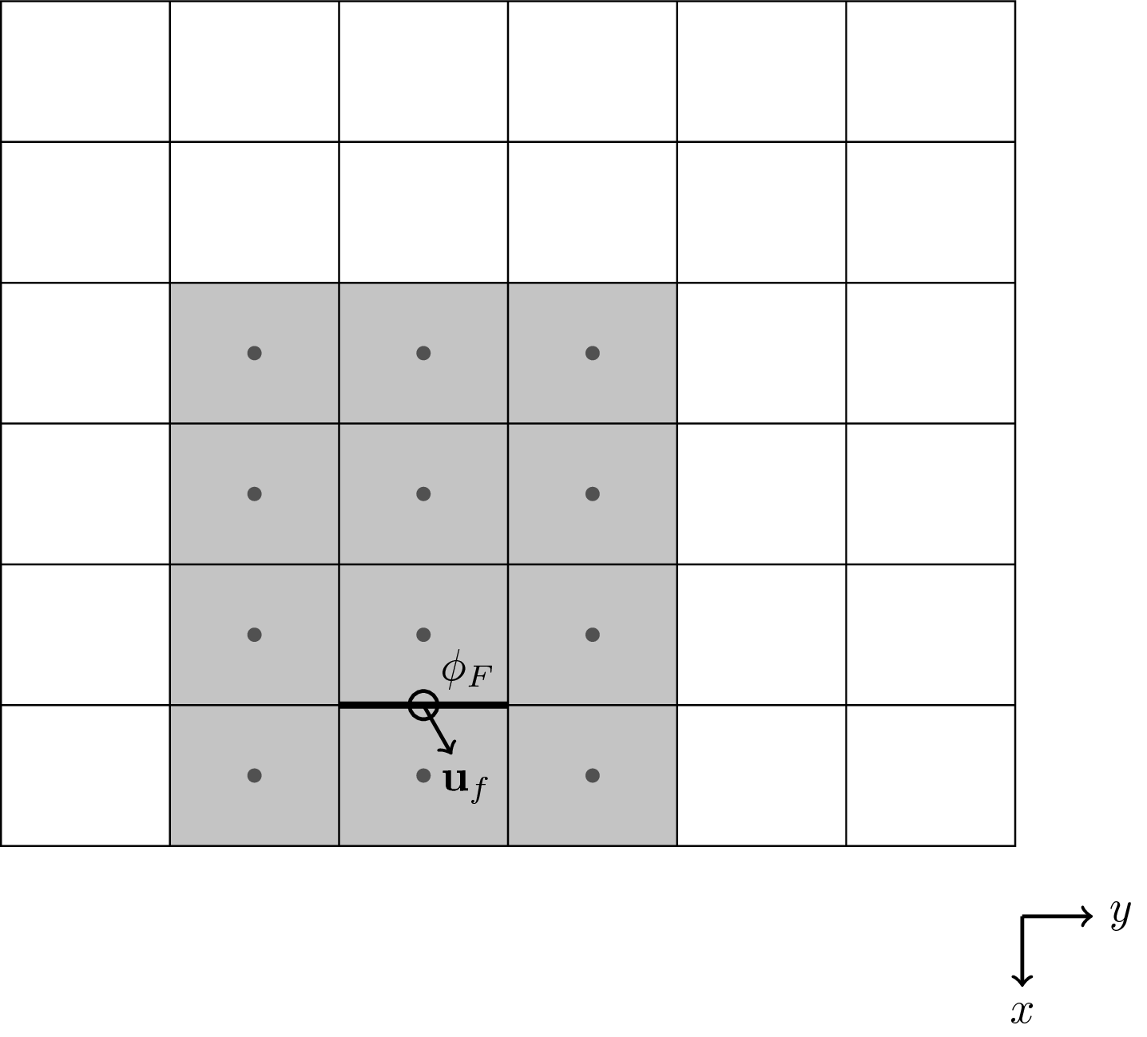
Stencil-Local Coordinates

Slide 14
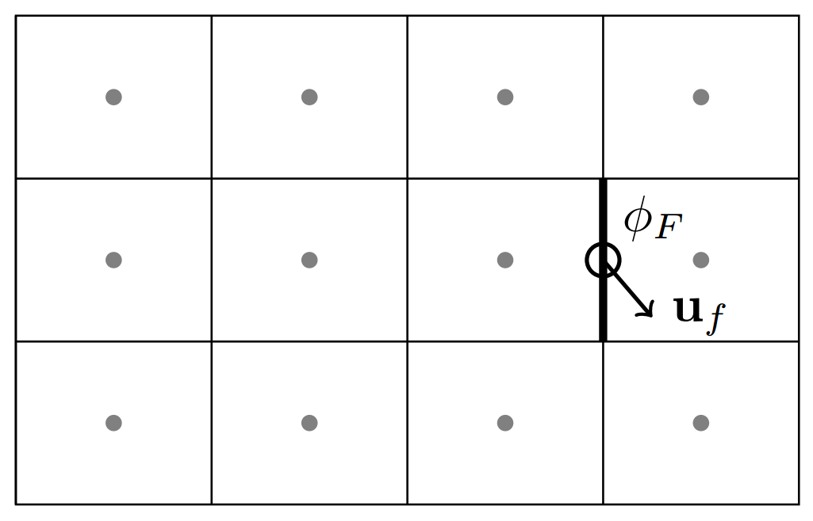
Least Squares Fit

Slide 15
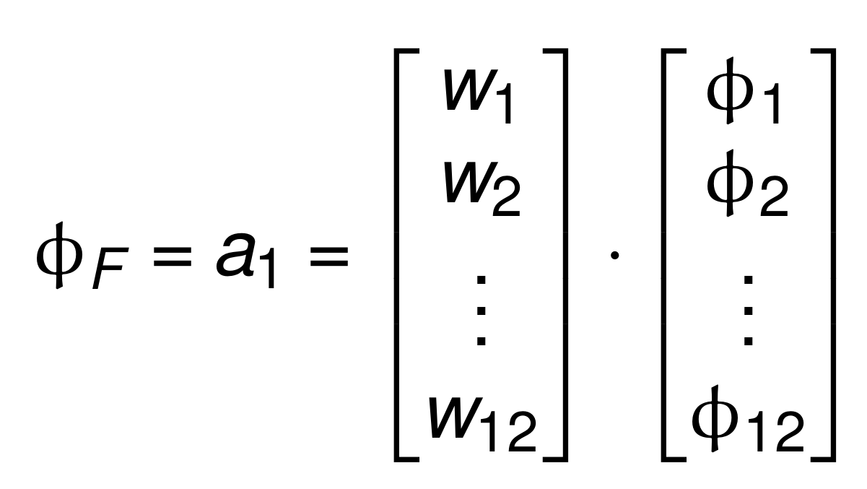
φ_{F} is Cheap To Compute

Slide 16
Estimating φ_{F} Near Boundaries

Slide 17
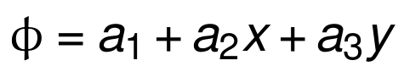

Slide 18
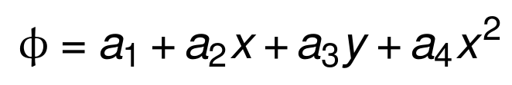
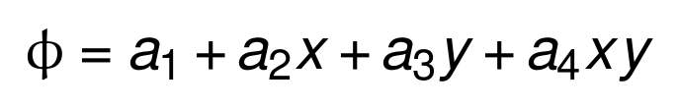

Slide 19
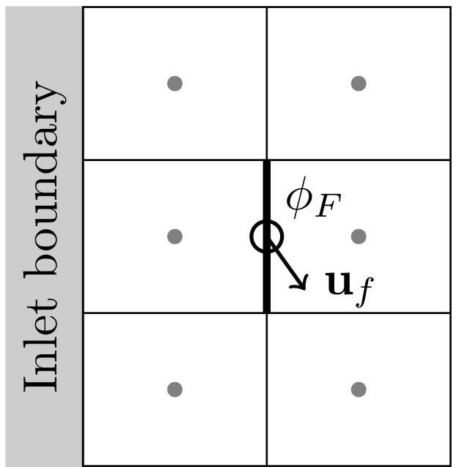
Estimating φ_{F} Near Boundaries
?

Slide 20
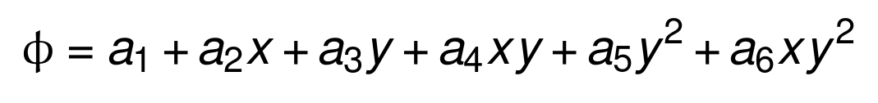
Estimating φ_{F} Near Boundaries

Slide 21
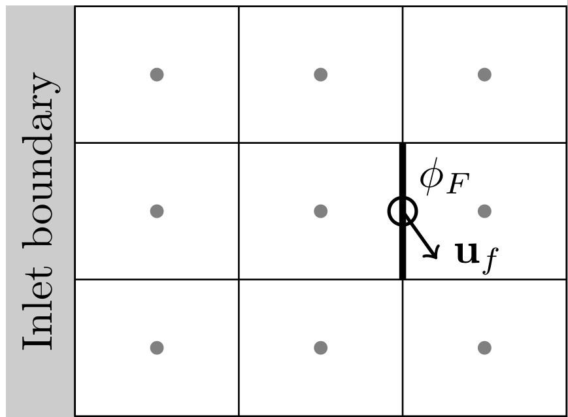
Estimating φ_{F} Near Boundaries
?

Slide 22
Estimating φ_{F} Near Boundaries

Slide 23
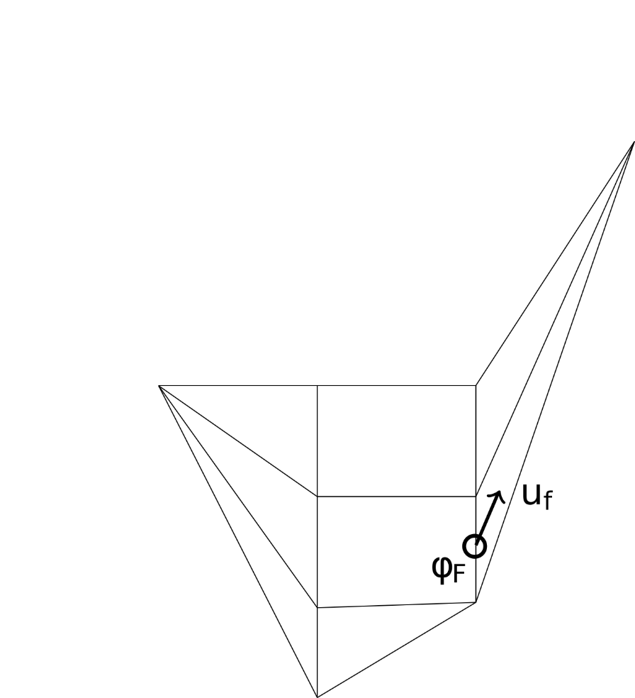
Estimating φ_{F} Near Boundaries
?

Slide 24
What is the most suitable polynomial
for a given distribution of points?

Slide 25
What is the highest degree polynomial
that ensures numerically stable advection?

Slide 26
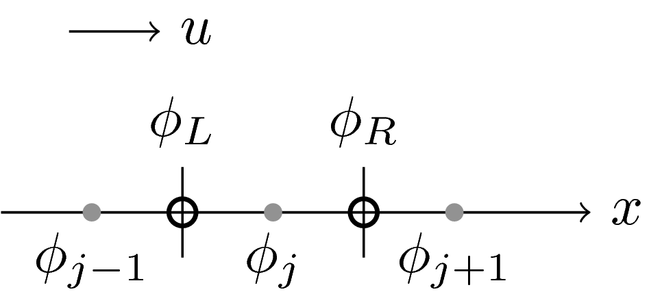
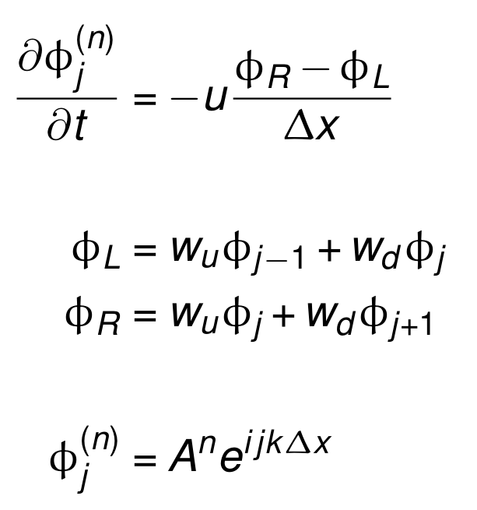
Von Neumann StabilitY

Slide 27
Von Neumann StabilitY

Slide 28
Von Neumann StabilitY
Assume perfect timestepping

Slide 29
Von Neumann StabilitY
Assume perfect timestepping
Assume wave-like solution

Slide 30
Von Neumann StabilitY
Assume perfect timestepping
Assume wave-like solution
Introduce constraints:
|A| <= 1

Slide 31
Von Neumann StabilitY
Assume perfect timestepping
Assume wave-like solution
Introduce constraints:
|A| <= 1
arg(A) < 0 for Co > 0

Slide 32
Von Neumann StabilitY
Assume perfect timestepping
Assume wave-like solution
Introduce constraints:
|A| <= 1
arg(A) < 0 for Co > 0
No more damping than first-order upwind (w_{u}=1, w_{d}=0)

Slide 33

Von Neumann StabilitY
2-point approximation

Slide 34
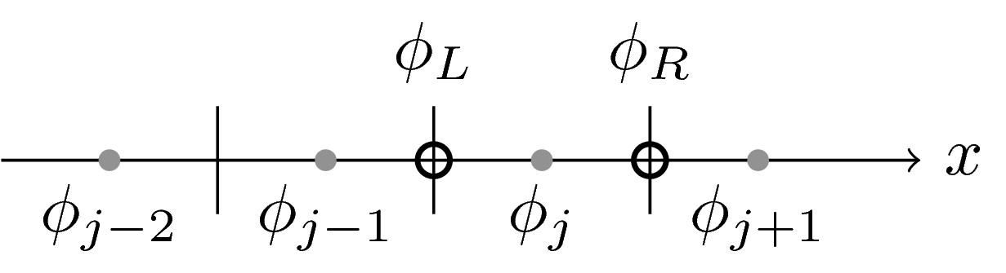
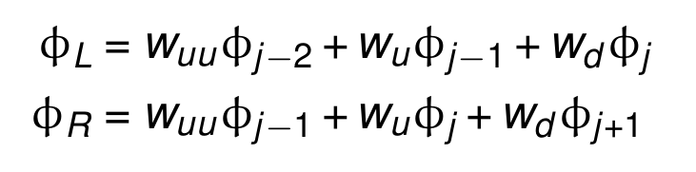
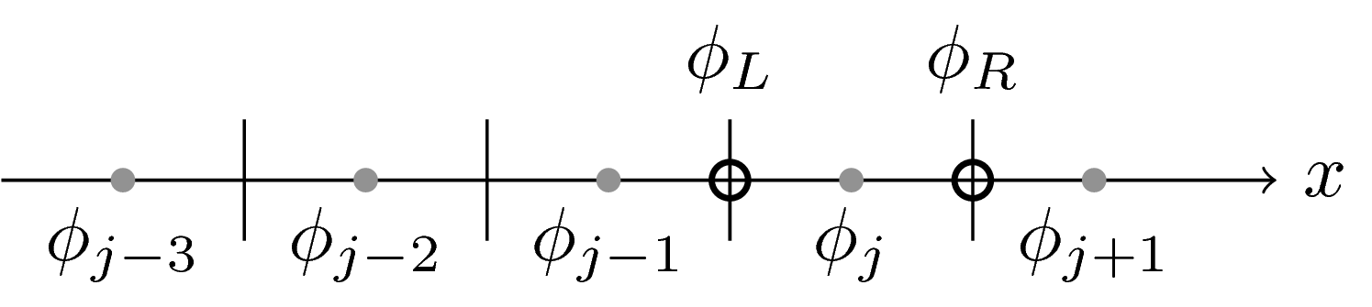
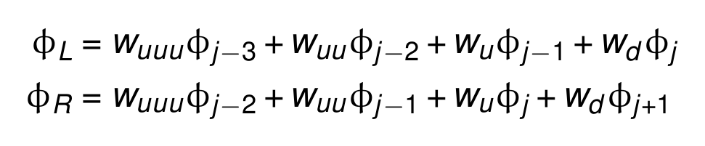
Von Neumann StabilitY
2-point approximation
3-point approximation
4-point approximation

Slide 35
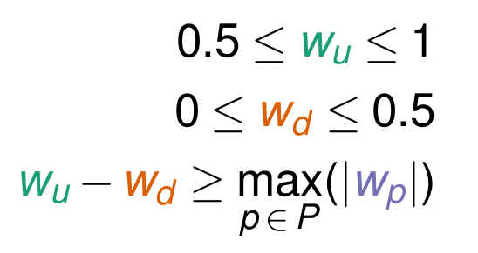
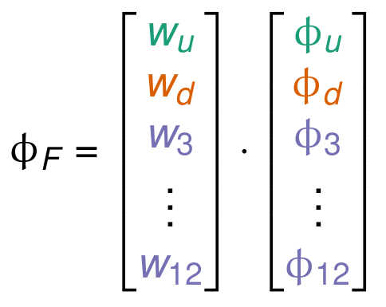
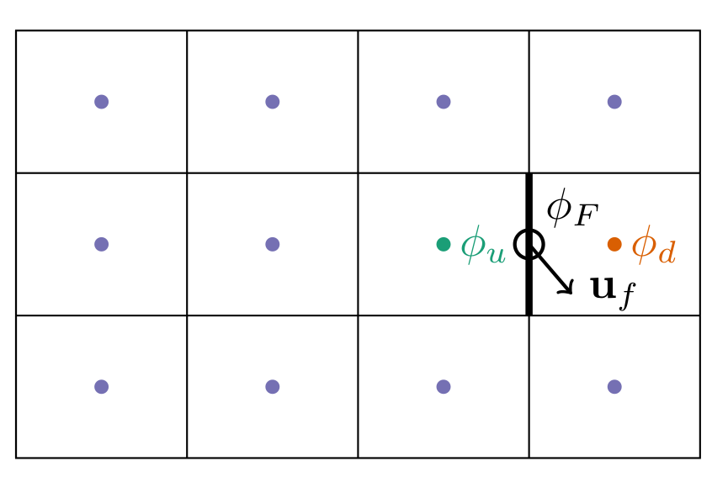
Von Neumann StabilitY

Slide 36
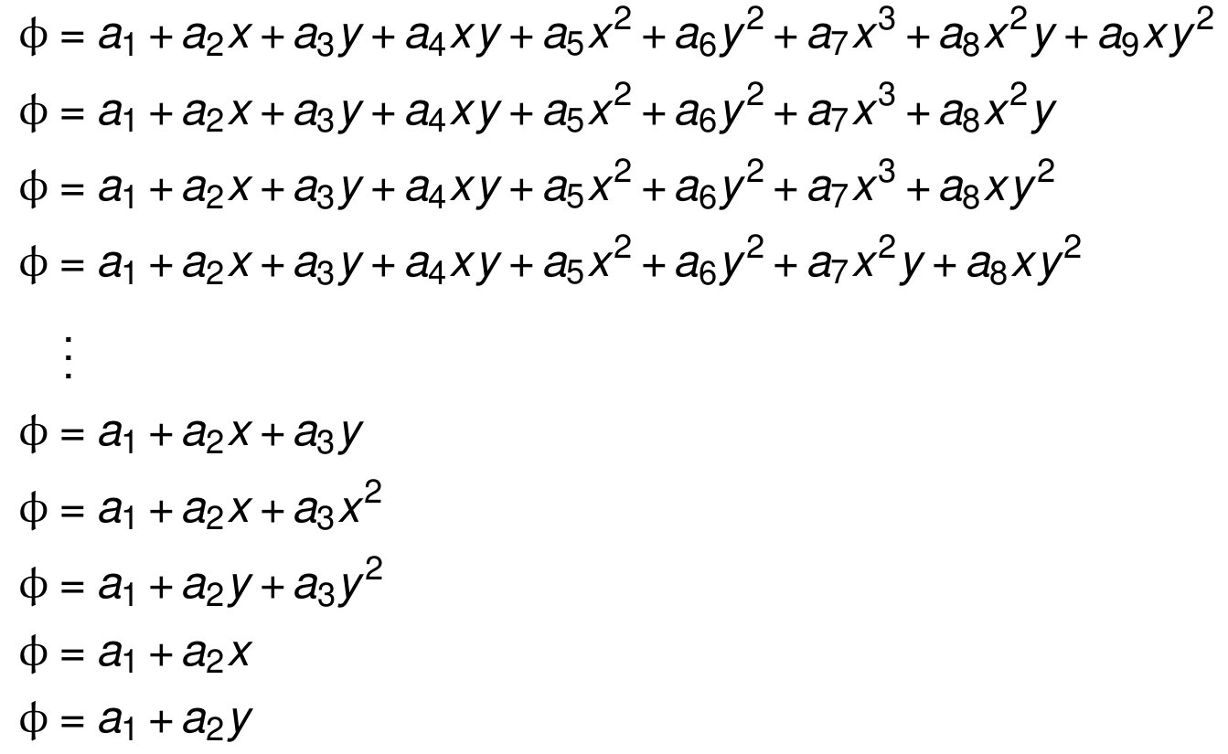
Polynomial Fit Algorithm
Generate candidate polynomials
Test each candidate against von Neumann stability criteria
Choose the best candidate that satisfies the criteria

Slide 37
Estimating φ_{F} Near Boundaries
?

Slide 38
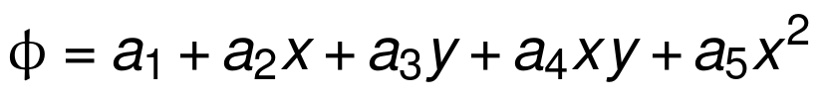
Estimating φ_{F} Near Boundaries

Slide 39
Numerical experiments
Schär horizontal advection over orography
“Slug” advection over orography

Slide 40
Numerical experiments
Schär horizontal advection over orography
“Slug” advection over orography
Compare
cubicFit
linearUpwind

Slide 41
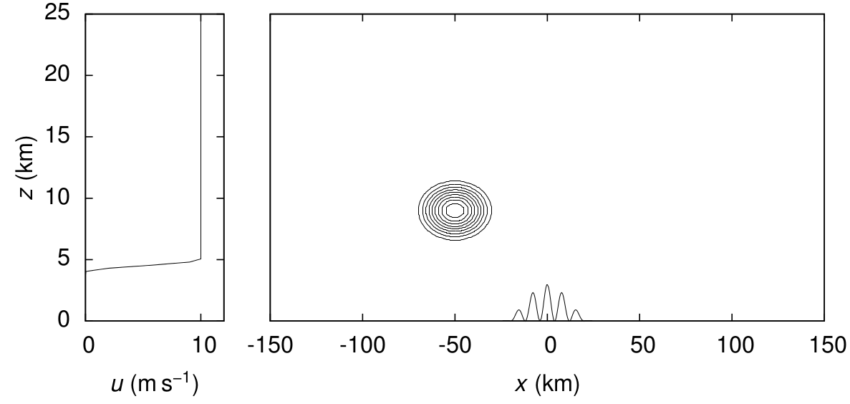
ScHäR HORIZONTAL ADVECTION
Horizontal wind profile, surface terrain profile and initial tracer Adapted from Schär et al. 2002, MWR

Slide 42
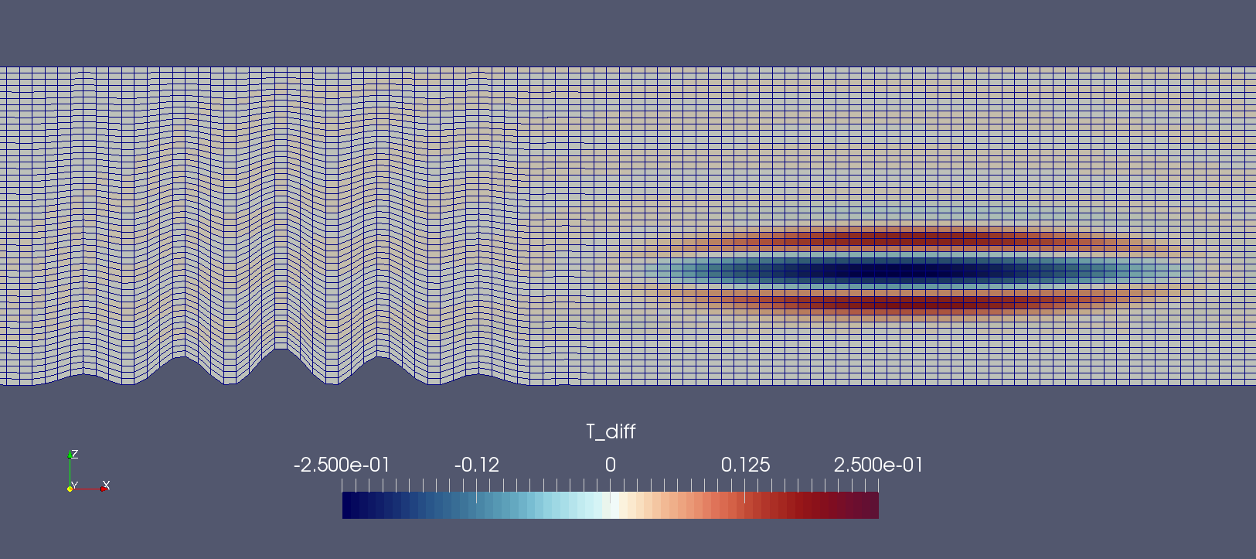
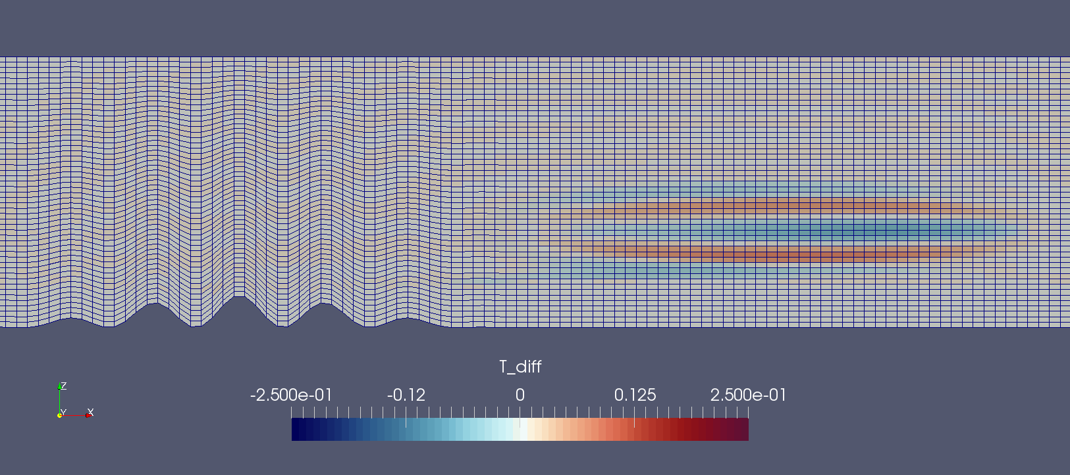
Basic terrain following
linearUpwind
cubicFit

Slide 43
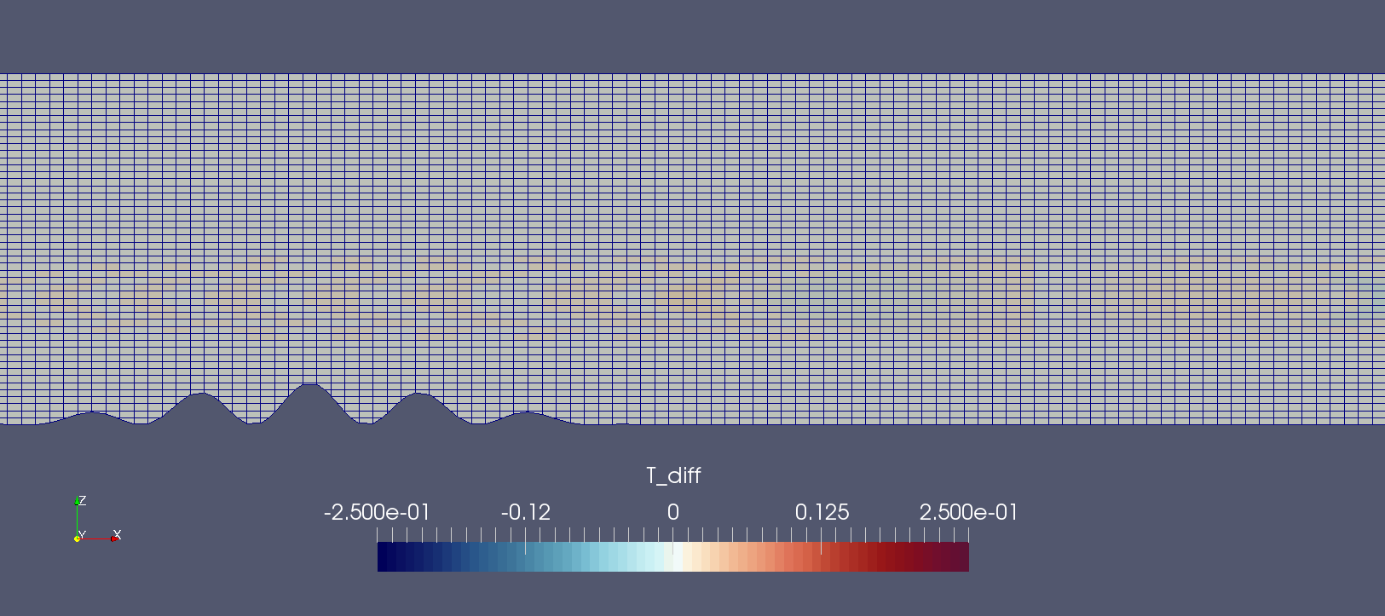
Cut Cells
linearUpwind
cubicFit

Slide 44
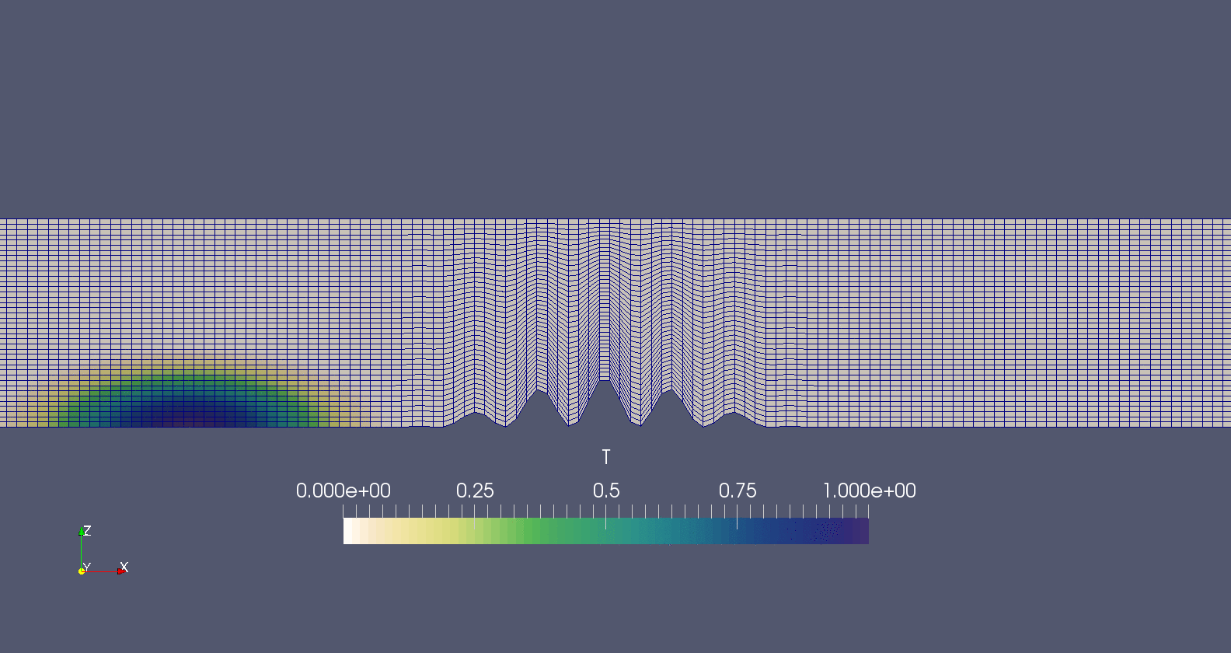
“Slug” Advection test
Animation

Slide 45
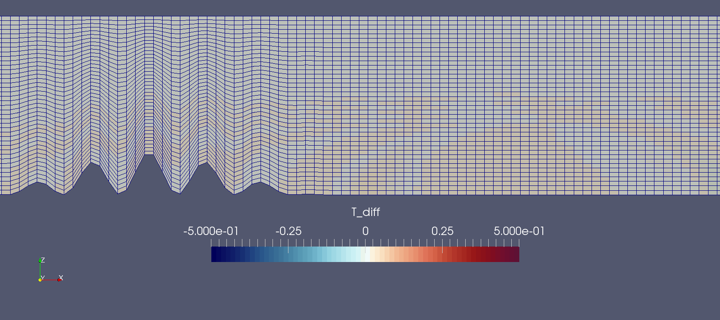
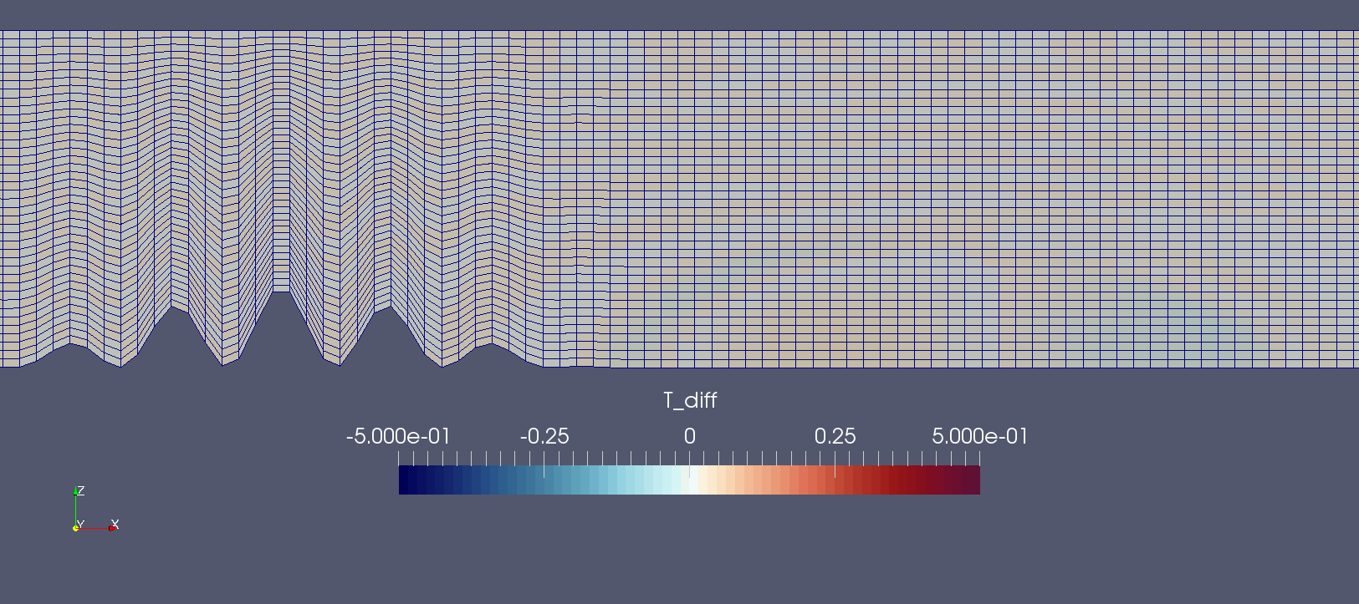
Basic terrain following
linearUpwind
cubicFit

Slide 46
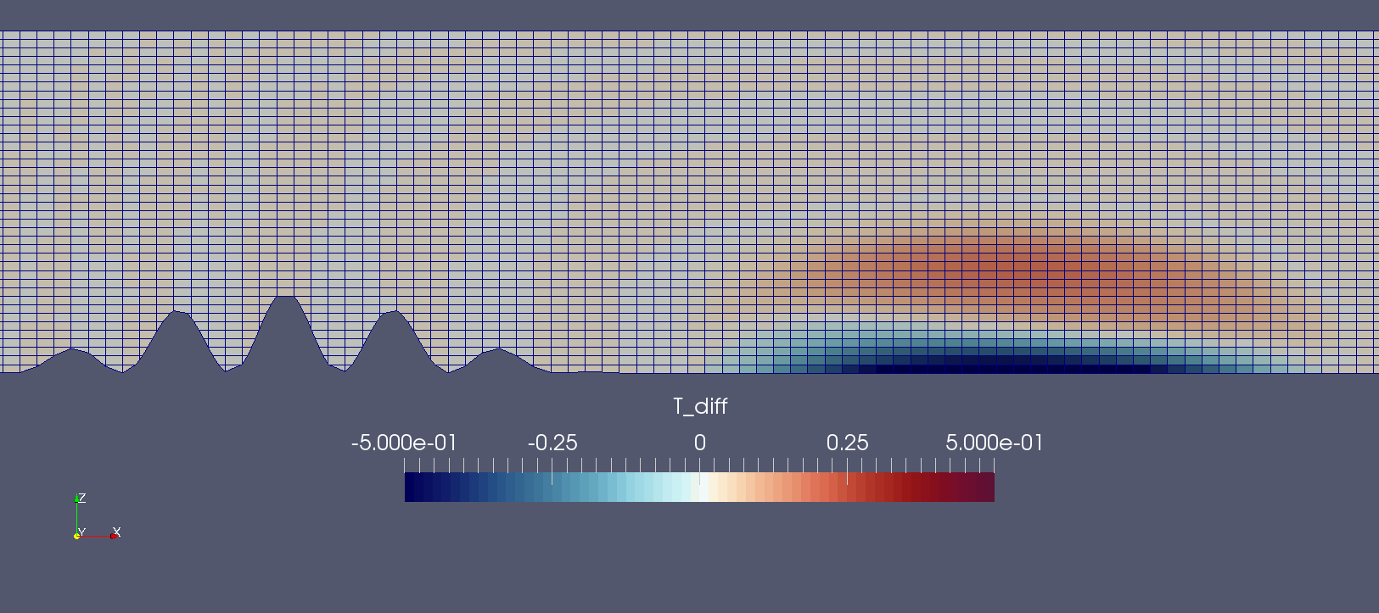
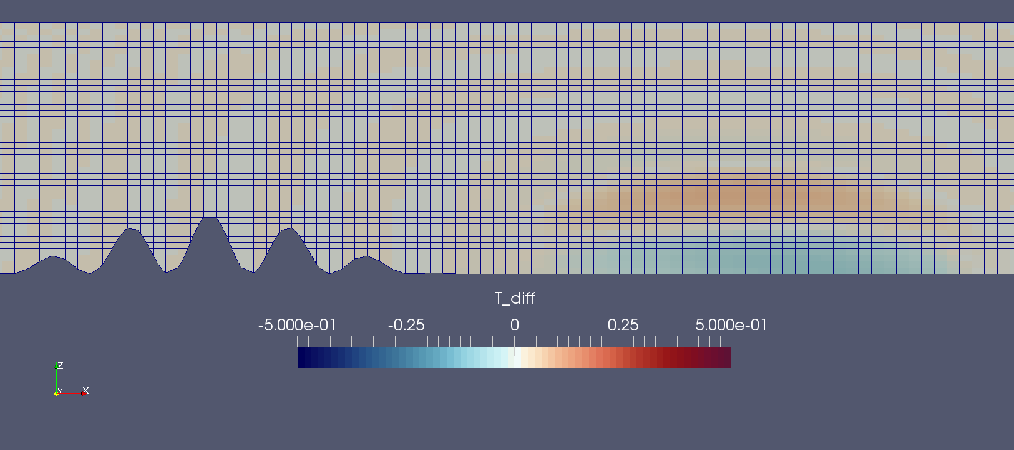
Cut cells
linearUpwind
cubicFit

Slide 47
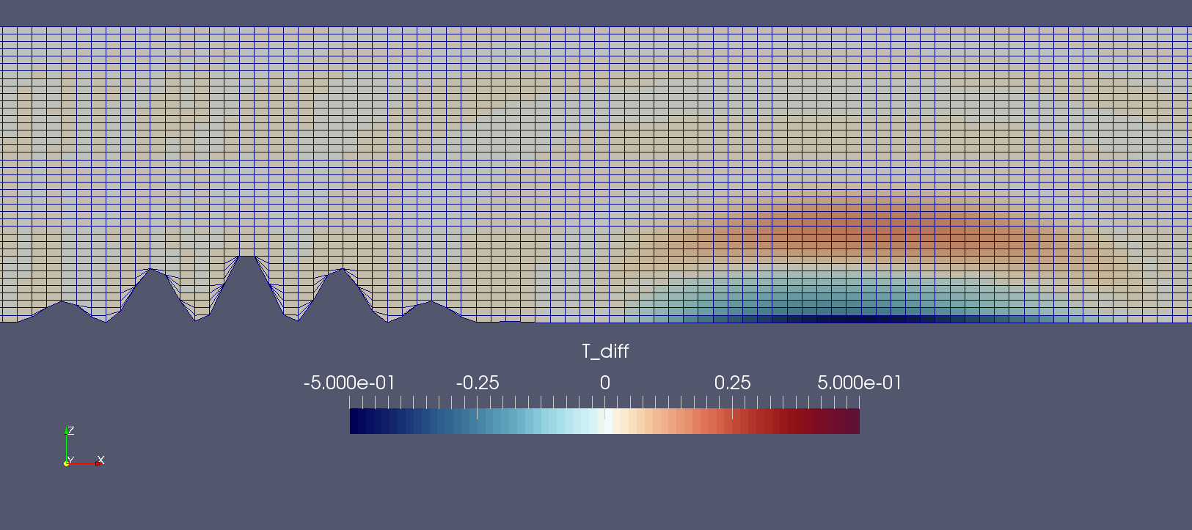
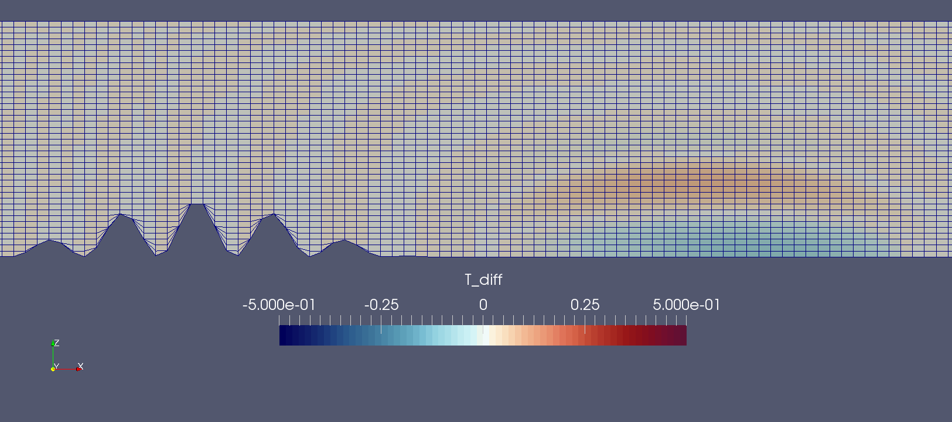
Slanted Cells
linearUpwind
cubicFit

Slide 48
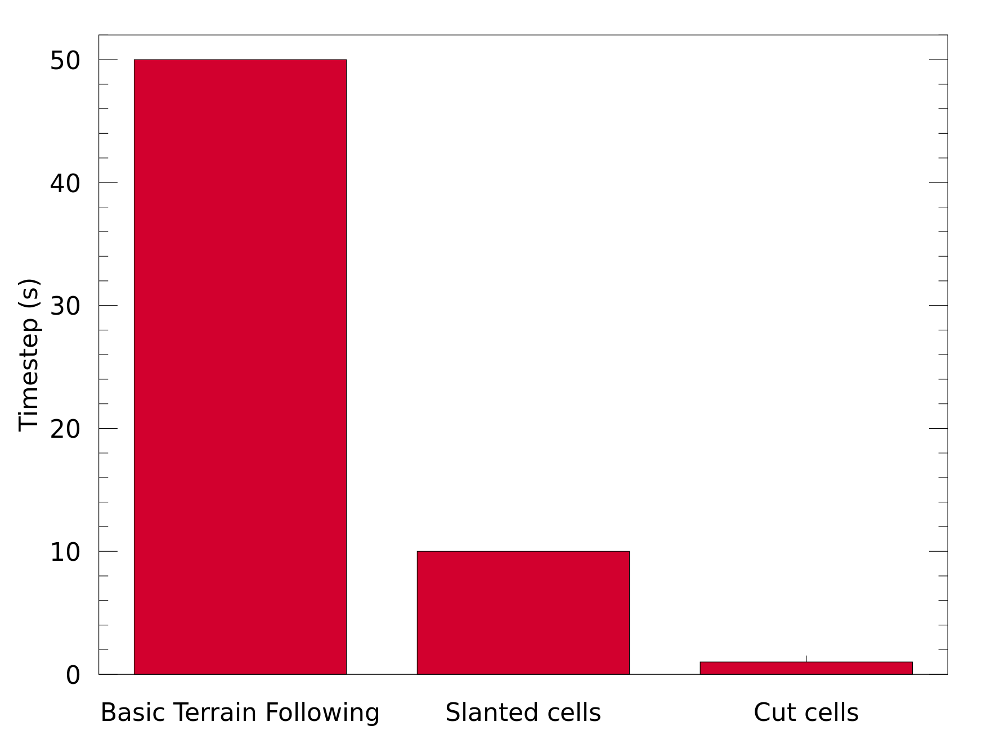
“Slug” Advection timesteps

Slide 49
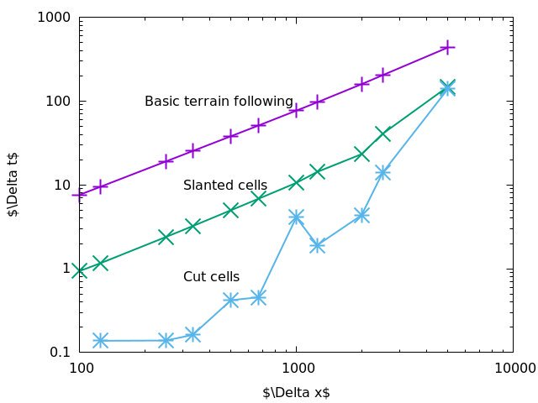
Maximum TimestepS
Δt
Δx

Slide 50
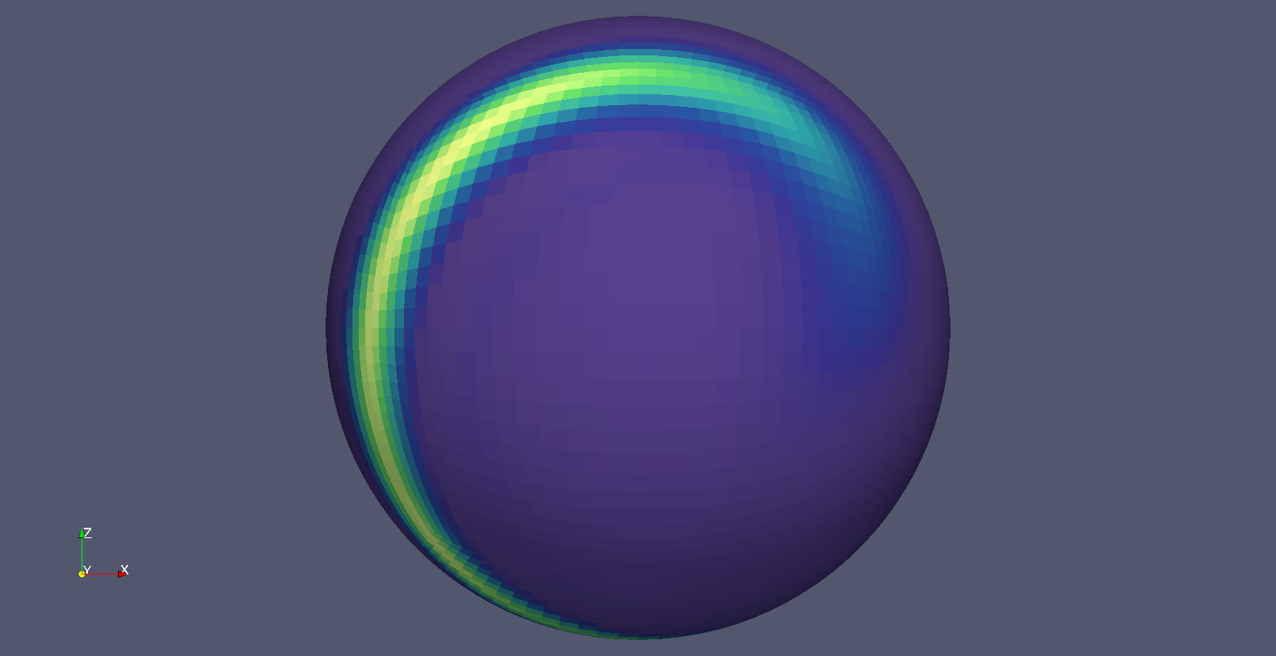
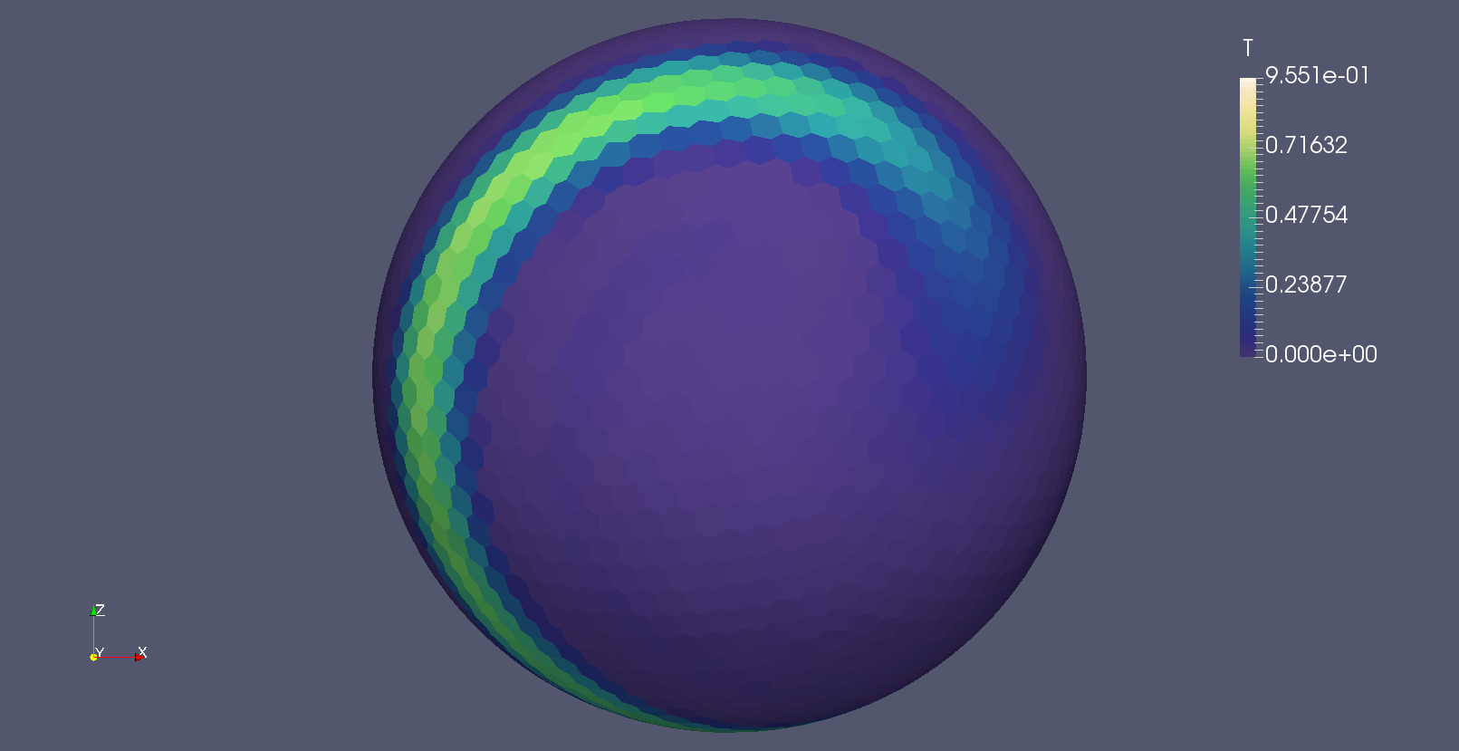
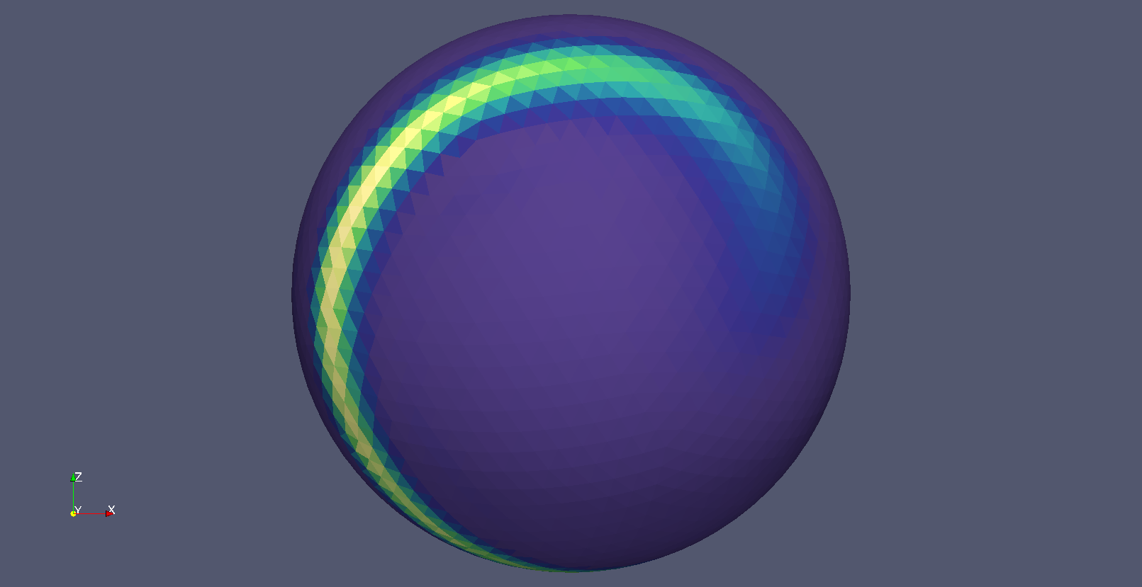
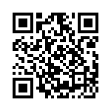
Conclusions
cubicFit is cheap to compute (dot product of two vectors)
cubicFit is suitable for many types of mesh
Maximum timesteps on slanted cells scale predictably with mesh spacing
Future work
Contact me: @hertzsprrrung or js102@zepler.net
Slides and additional resources: goo.gl/jLR7vW

